Slide 1
Multi Energy Systems: Investigating Hidden Flexibilities Provided by Power-to-X Considering Grid Support Strategies
MSc: Bekir Caner Yagci (4857089)
PhD: Digvijay Gusain
Supervisor: Asst. Prof. Milos Cvetkovic
Delft University of Technology
Faculty of Electrical Engineering,
Mathematics, and Computer Science

Slide 2
Content
Introduction
Research Problem
Flexibility
Research Questions
Methodology
Multi-Energy System Design
Energy Demand Profiles
Modelling & Analysis
PEM Electrolyser
Electric Heat Pump
Power-to-X Models
Analysis
Adjustable Power Level Controller
Co-simulation Setup
Results
Conclusion

Slide 3
Introduction - Research Problem
Variable nature of renewable energy sources introduces a great challenge for grid operator to balance the electricity supply and demand
Replacing production based on fossil fuels in industries, such as chemicals, petrochemicals, food, steel cement; leads to more sustainable and flexible multi-energy systems
Due to approximations made in model formulations (constant / linear relation between power input and energy output), flexibilities provided by PtX to network can be concealed in the simulation results
Correct efficiency characterization of PtX is crucial to analyze flexibility of power system. Inaccurate efficiency models of PtX may lead to increased transmission losses, higher operational cost or misinterpretation of MES capacity
Existing energy management models for MES do not consider energy cost of production (€/MWh). This results with unnecessary trading of electricity and increase in operational cost
MES: Multi Energy System
PtX: Power-to-X

Slide 4
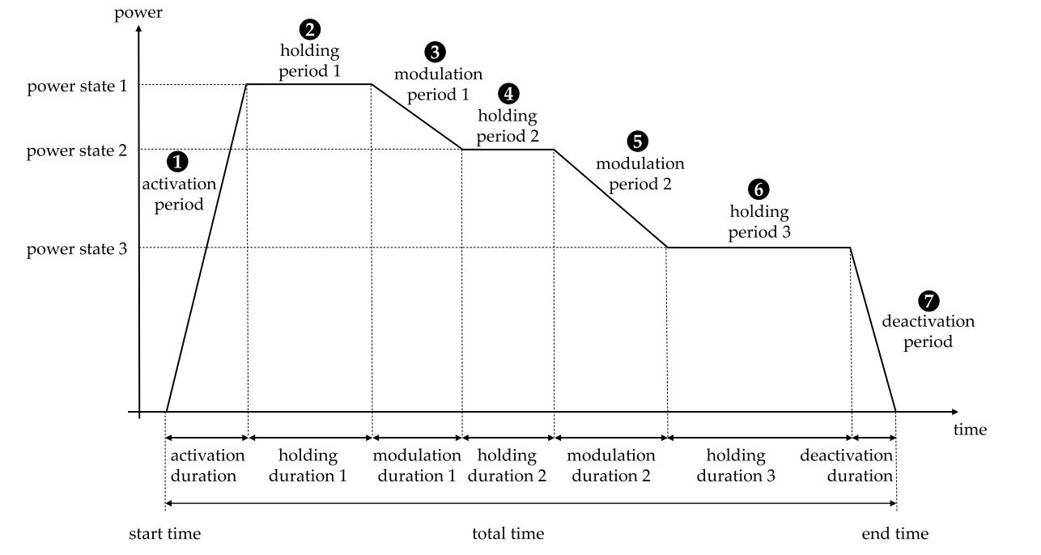
Introduction - Flexibility
” Flexibility is the ability of a component or a collection of components to respond power fluctuations in power systems. ”
In this project, PtX devices and the flexibility offered by them to support power system is analyzed.
PtX technogy offers;
Larger power balance flexibility
for the grid
Opportunities for demand flexibility
by storage elements
Additional information obtained from detailed models during flexibility analysis is defined as the hidden flexibility of PtX
An exemplary flexible load measure with the corresponding parameters [1]
PtX: Power-to-X

Slide 5
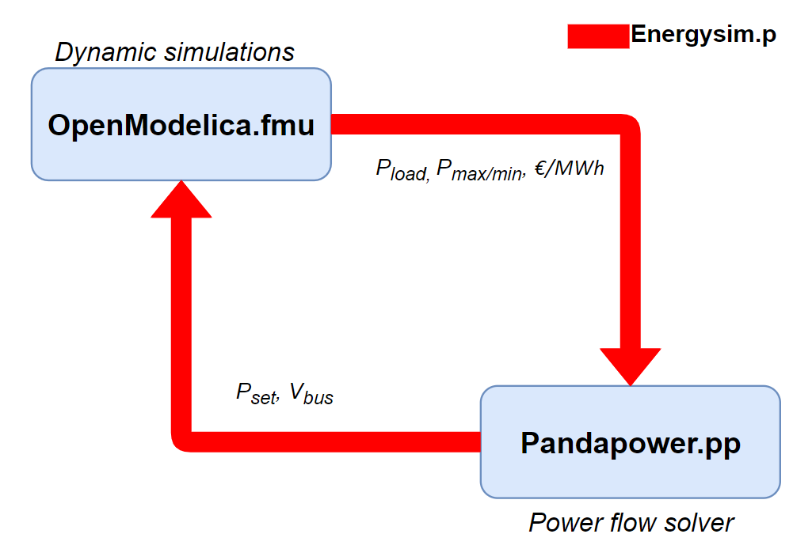
Introduction - Research Questions
Which technologies have the highest potential to provide flexibility?
Which options are available in industrial area?
What are the options in order to increase flexibility of an industrial grid?
To what extent does model fidelity impact flexibility analysis?
Which assumptions can be made and which physical effects should be considered?
What should be the modelling considerations for accurate flexibility results?
How to manage optimal deployment of flexibility considering individual resource constraints?
How to combine models representing different energy vectors efficiently?
How complex simulations can be created for energy management of MES?
MES: Multi Energy System
Co-simulation Approach

Slide 6
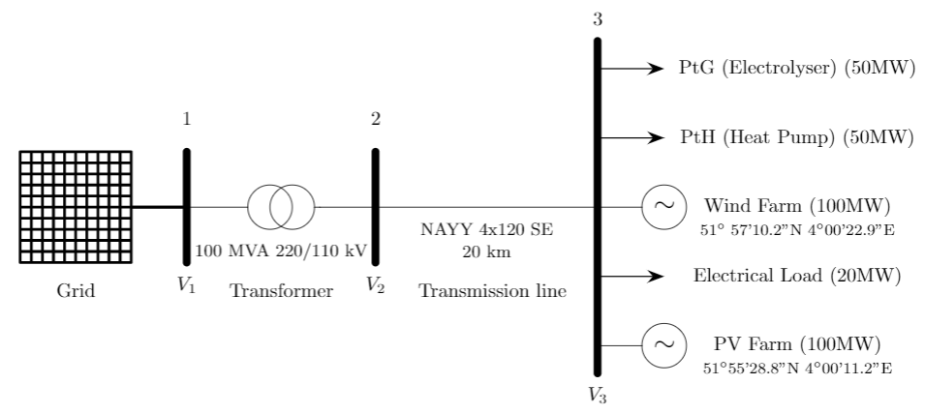
Methodolgy – MES Design
PEM Electrolyser is one of the most convenient options as a result of hydrogen characteristics.
Electric heat pumps with auxiliary boilers are commonly recommended for their high efficiencies (Bode & Schmitz, 2018).
The hourly power output of RES is calculated from Renewables.ninja [2]
PEM: Proton Exchange Membrane
PtG: Power-to-Gas
PtH: Power-to-Heat
RES: Renewable Energy Sources

Slide 7
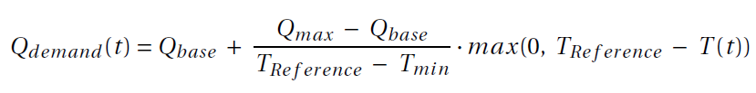
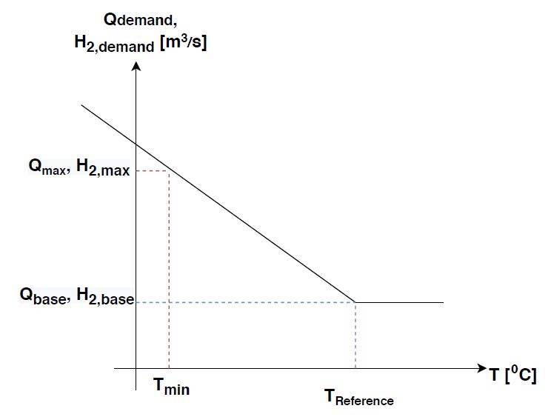
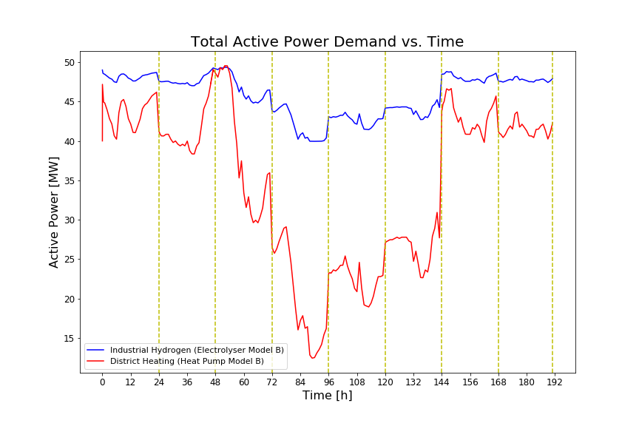
Methodolgy – Energy Demand Profiles
Historical ambient temperature data is used for the calculation of energy demand profiles
Mathematical formulation of Felten,
Baginski, and Weber (2017) model:
 | T_{R} [⁰C] | T_{min} [⁰C] | Q₀ [m³/s] | Q_{max} [m³/s]
Industrial PtG | 25 | 5 | 3.14e-03 | 3.85e-03
District Heating PtH | 25 | 5 | 3 | 4
The relation between ambient temperature and hydrogen & heat demand [1]
PtG: Power-to-Gas
PtH: Power-to-Heat

Slide 8
Modelling – PEM Electrolyser
Temperature dependency of electrolyser efficiency is considered
Electrolyser performance is calculated considering operational conditions (temperature, pressure, cell current effects)
Balance of plant elements are considered for temperature evolution
Model | Physical Domains | Modelling Approach | Dynamic Behaviour | Modelling Scale
A | Electrochemical Electrical | Analytic + Empirical | Static | Cell/Stack
B | Electrochemical Electrical Thermal | Analytic + Empirical | Static + Dynamic (ODE) | Cell/Stack + BOP
MES: Multi Energy System
ODE: Ordinary Differential Equation
BOP: Balance of Plant

Slide 9
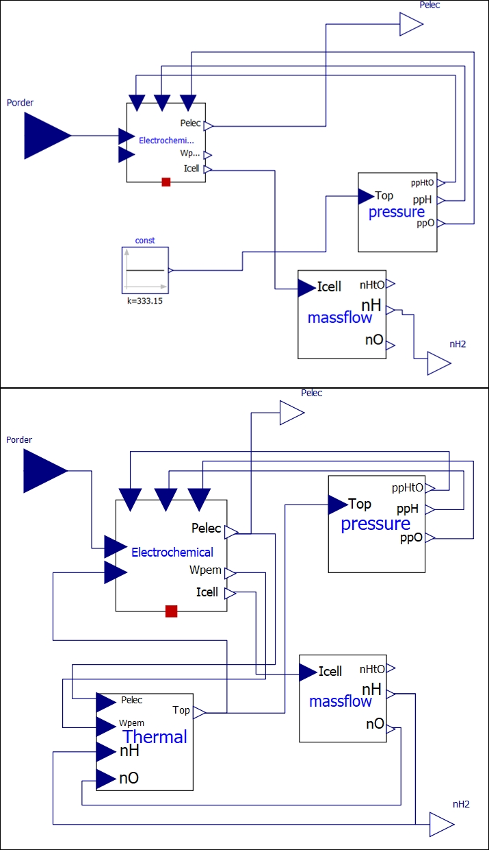
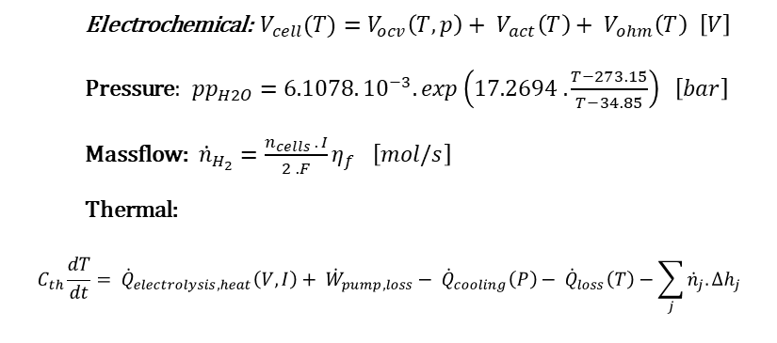
Modelling – PEM Electrolyser
Model A
Electrochemical: $V_{cell}(T)=V_{ocv}\left(T,p\right)+ V_{act}\left(T\right)+ V_{ohm}\left(T\right) \left[V\right]$
Pressure:${pp}_{H2O}=6.1078.{10}^{−3}. exp\left(17.2694 . \frac{T−273.15}{T−34.85}\right) \left[bar\right]$
Massflow:${\dot{n}}_{H_{2}}=\frac{n_{cells} . I}{2 . F}η_{f} \left[mol/s\right]$
Thermal:
$$C_{th}\frac{dT}{dt}= {\dot{Q}}_{electrolysis,heat}\left(V,I\right)+ {\dot{W}}_{pump,loss}− {\dot{Q}}_{cooling}\left(P\right)− {\dot{Q}}_{loss}\left(T\right)−\sum_{j}{{\dot{n}}_{j}.{∆h}_{j}}$$
Model B
Thermal submodel
BOP: circulation pump, cooling system
Static vs. First order dynamics
BOP: Balance of Plant

Slide 10
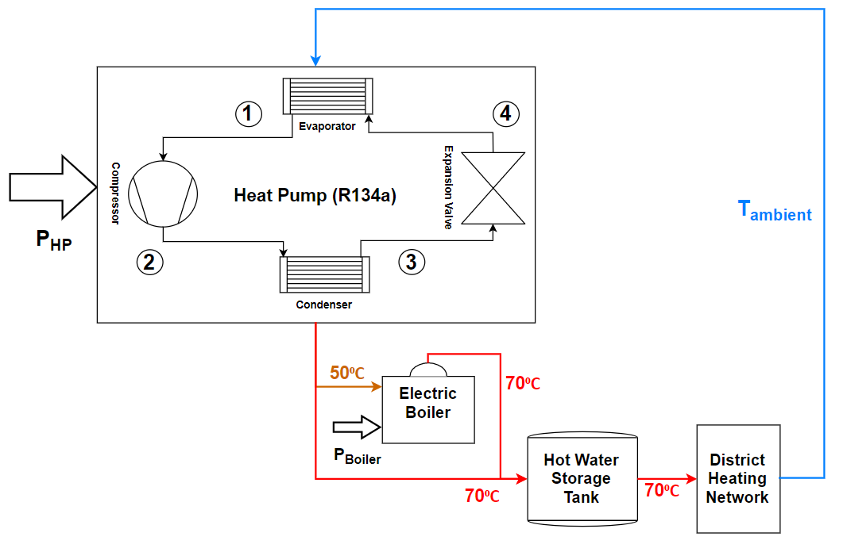


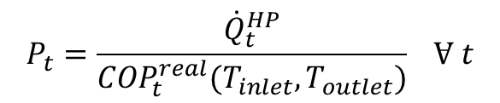
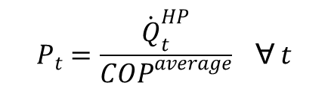
Modelling – Electric Heat Pump
Model A:
$$P_{t}=\frac{{\dot{Q}}_{t}^{HP}}{{COP}^{average}} Ɐ t$$
Model B & C:
$$P_{t}=\frac{{\dot{Q}}_{t}^{HP}}{{COP}_{t}^{real}(T_{inlet},T_{outlet})} Ɐ t$$
Model C:
$$if T_{amb}<15{}_{}^{0}C then T_{cond}=50{}_{}^{0}C$$
$$Q_{boiler}=\dot{m}.c.∆T, η_{boiler}=0.99$$
Model | Modelling Approach | Ambient Temperature | Modelling Scale
A | Regression | Daily Average | Heat Pump
B | Regression | Hourly Measured | Heat Pump
C | Regression | Hourly Measured | Heat Pump with Auxiliary E-Boiler

Slide 11
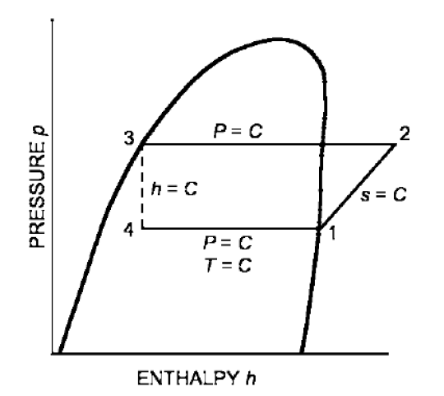
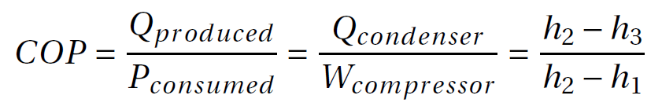
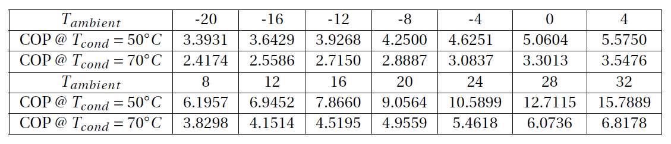
Modelling – Electric Heat Pump
Pressure – Enthalpy table of refrigerant R-134a is used for enthalpy calculations with the assumptions shown in the figure
COP results for various ambient and condenser temperatures:
Figure: Theoretical Single-Stage Vapor Compression Refrigeration Cycle (C:Constant )

Slide 12
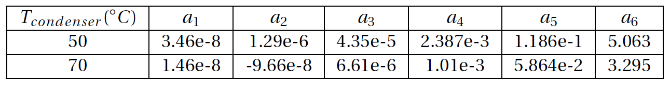
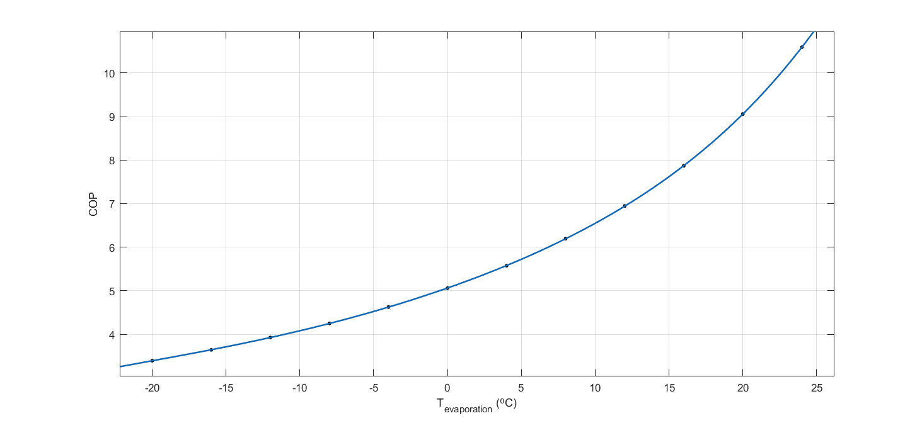
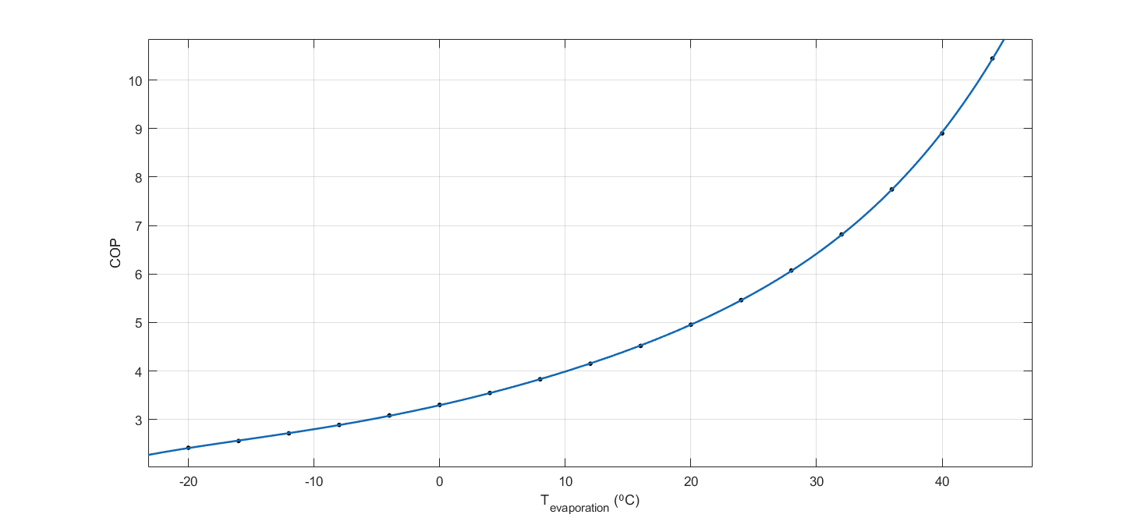
Modelling – Electric Heat Pump
5th order polynomial fuction parameters for T_{condenser} = 50,70 ⁰C
COP curve fitting result for T_{cond} = 50 ⁰C
COP curve fitting result for T_{cond} = 70 ⁰C

Slide 13
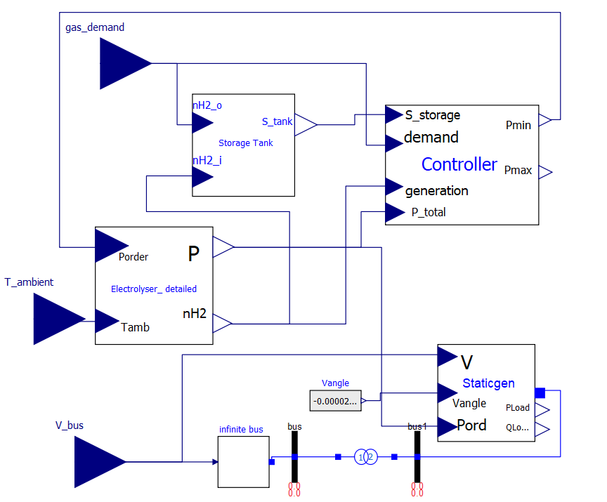
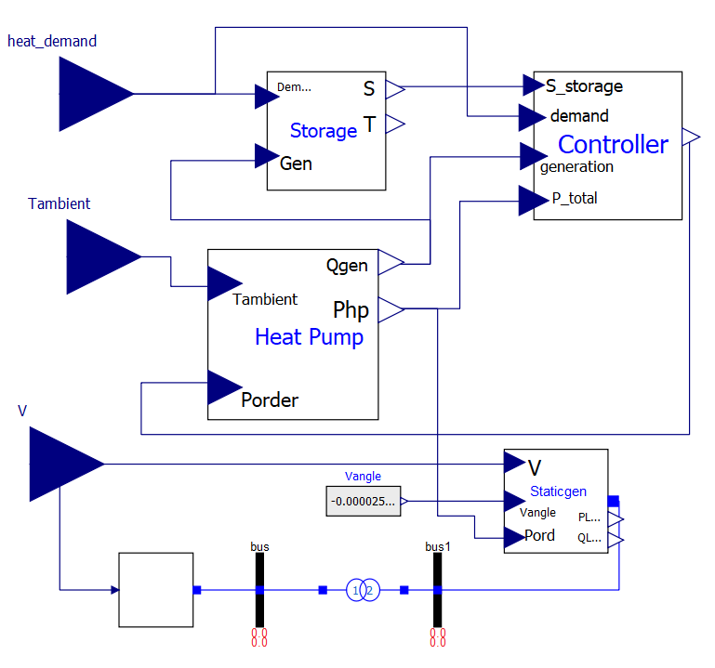
Modelling - Power-to-X Models
Power-to-Gas
Power-to-Heat
Electrolyser & Heat Pump, calculate energy output based on power input and operating conditions
Controller, calculates P_{min}, P_{max} constraints for PandaPower
Storage, calculates amount of stored energy in m³
StaticGenerator, provides electrical interface and controls Q_{load}

Slide 14
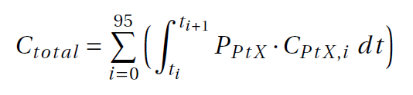
Analysis
Multi-Energy System Analysis:
It is carried out in order to investigate the seasonal weather behaviour in the area and flexible capacity of MES.
Power-to-X Analysis:
Efficiency characters of different models compared in order to investigate the effect of temperature evolution on device performance.
Power System Analysis:
Base case: It is assumed that none of the PtX is available for flexibility service. Without any flexibility service, measuring the flexible demand of MES.
First case: It is assumed that only one PtXs are available for flexibility service. Comparing both PtX options with respect to reduction in flexible demand of MES after flexibility service. Comparing the energy output of PtX model A, B, C for the same flexibility service.
Second case: It is assumed that both PtXs are available for flexibility service. Considering cost signals and adjustable power level constraints, measuring the deployment of flexibility between PtG & PtH and quantifying the reduction in total operational cost.
MES: Multi Energy System
PtG: Power-to-Gas
PtH: Power-to-Heat

Slide 15


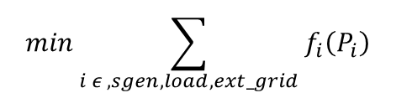
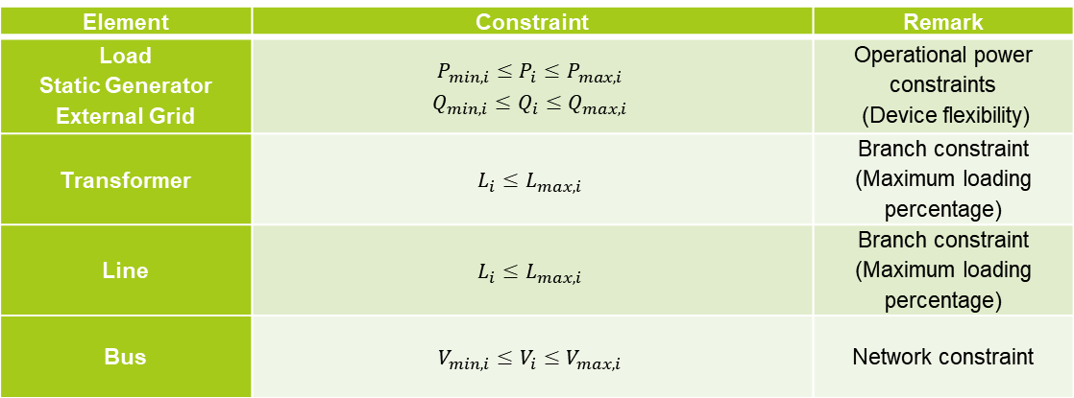
Co-Simulation - Optimum Deployment of Flexibility with Hierarchical Energy Management
$$min\sum_{i ε , sgen, load,ext_grid}{f_{i}\left(P_{i}\right)}$$
Objective function:
$$f_{pol}\left(P\right)=c_{n}P^{n}+…+c_{1}P+c_{0}$$
Cost function:
Constraints:
Element | Constraint | Remark
Load Static Generator External Grid | $$P_{min,i}≤P_{i}≤P_{max,i}$$ $$Q_{min,i}≤Q_{i}≤Q_{max,i}$$ | Operational power constraints (Device flexibility)
Transformer | $$L_{i}≤L_{max,i}$$ | Branch constraint (Maximum loading percentage)
Line | $$L_{i}≤L_{max,i}$$ | Branch constraint (Maximum loading percentage)
Bus | $$V_{min,i}≤V_{i}≤V_{max,i}$$ | Network constraint

Slide 16
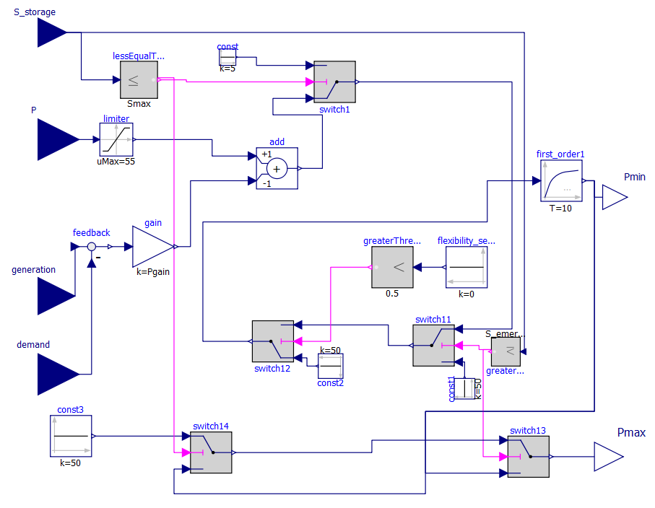
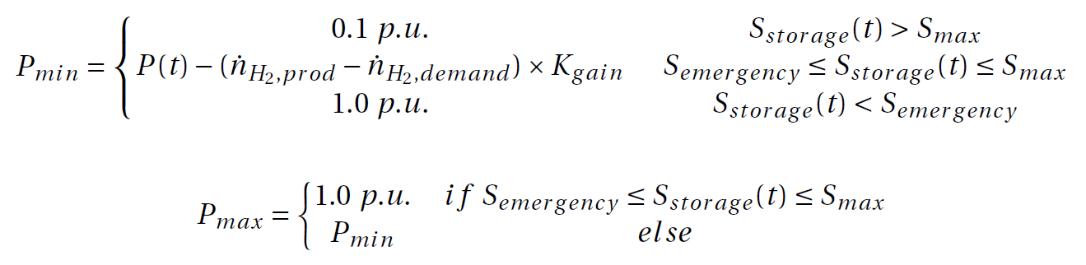
Modelling – Adjustable Power Level Controller
Constraint decision making:

Slide 17
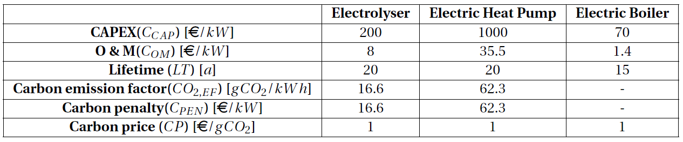
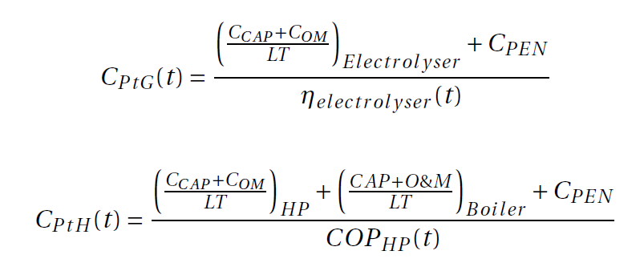

Co-Simulation - Levelized Cost of Energy
${\text{Cost} \text{function}\text{: } f}_{pol}\left(P\right)=c_{1}P$
Calculates $c_{1}$ $[EUR/MWh]$

Slide 18
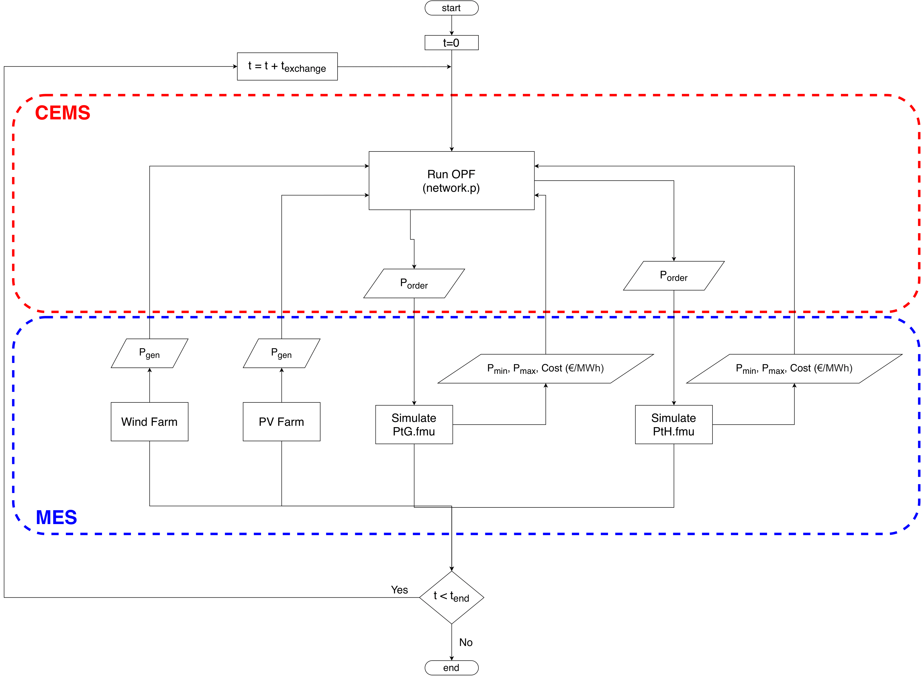
Co-simulation Flow Chart
MES: Multi Energy System
CEMS: Community Energy Management System
OPF: Optimal Power Flow
Notes:
The figure includes the
processes that allow for the storage and transport of electrical energy (Gray blocks)

Slide 19
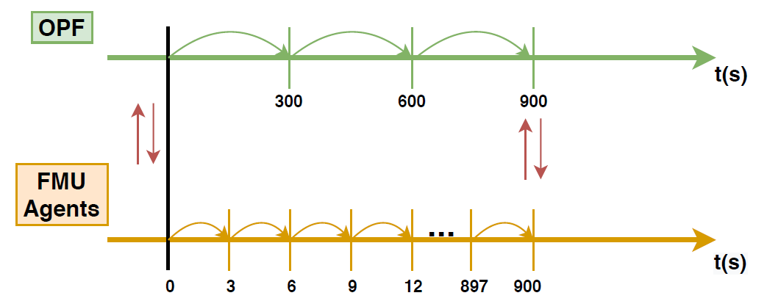
Simulation Tools
OpenModelica
For fast simulation of complex dynamics from different energy domains, using object-oriented programming language
To export FMU’s for co-simulation
Pandapower
Optimal power flow solver
Used for the energy management of MES for various co-simulation cases
Energysim (Co-simulation)
Allows to implement complex simulations with reduced computational burden by exchanging only necessary variables.
Co-simulation step and exchange times
I/O: Input/Output
FMU: Functional Mock-up Unit
OPF: Optimal Power Flow

Slide 20
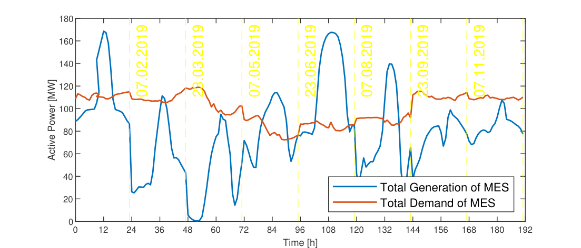
Results - MES Analysis

Slide 21
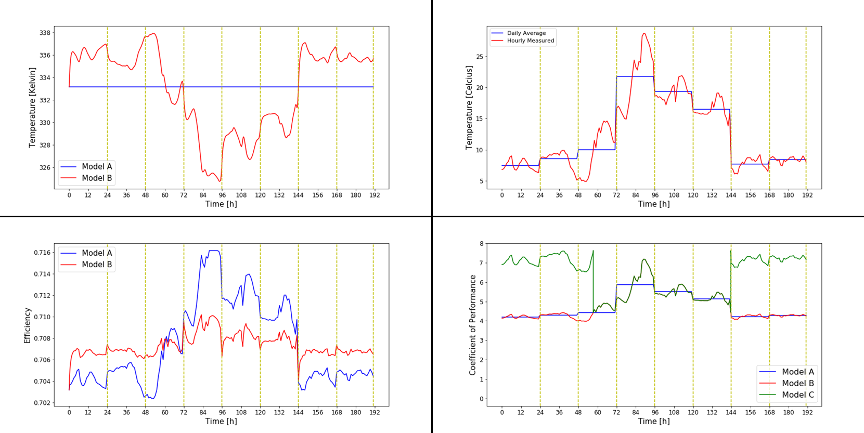
Results – PtX Analysis
Max ∆T = 13
Max ∆T = 7
Max ∆η = 0.6%
Max ∆COP_{AB} = 1.4
Max ∆COP_{BC} = 3

Slide 22
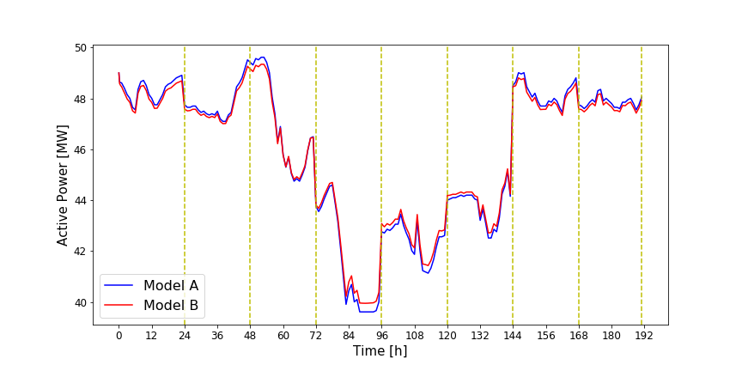
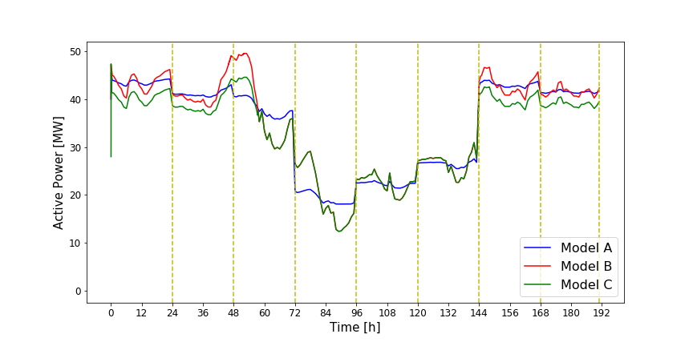
Results – PtX Analysis
Max ∆P = 0.4 MW
Max ∆P_{AB} = 1.4 MW
Max ∆P_{BC} = 5 MW

Slide 23
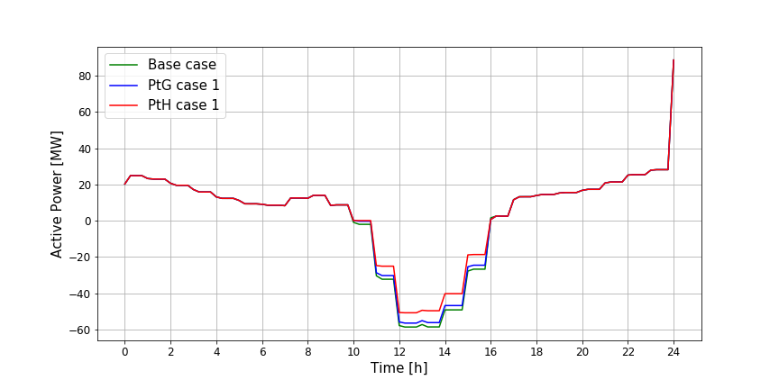
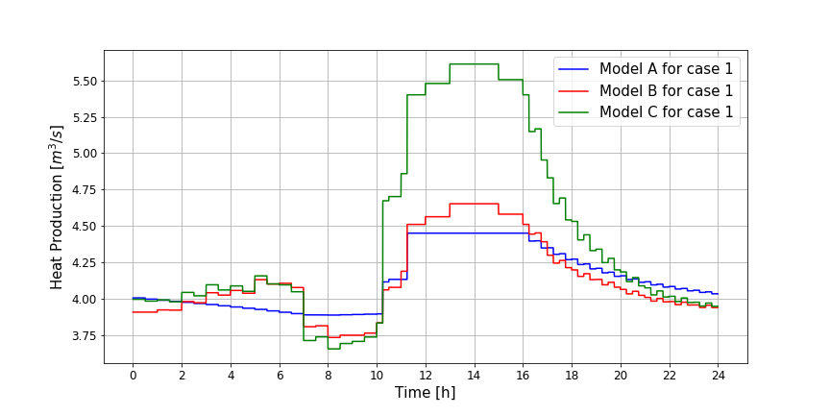
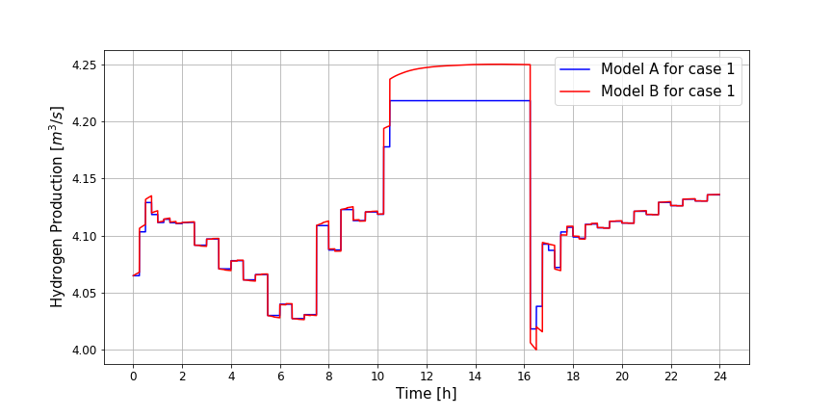
Results – Power System Analysis, Case 1
Max ∆P_{base-ptg} = 2 MW
Max ∆P_{base-pth} = 10 MW
Max ∆Q_{A-B} = 0.20 m³/s
Max ∆H₂ = 0.032 m³/s
Max ∆Q_{B-C} = 0.96 m³/s

Slide 24
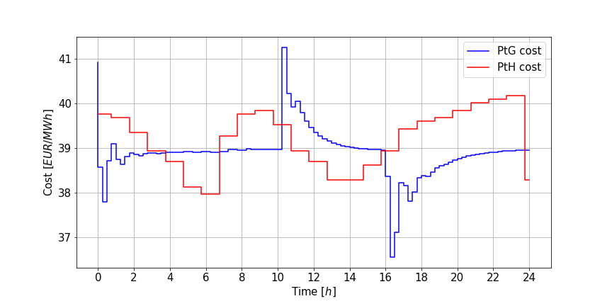
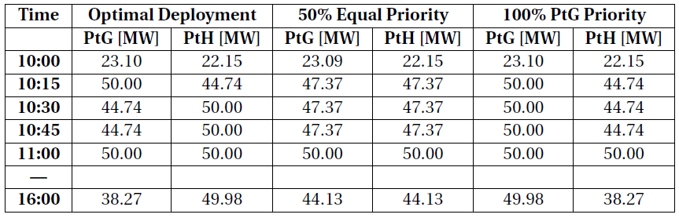
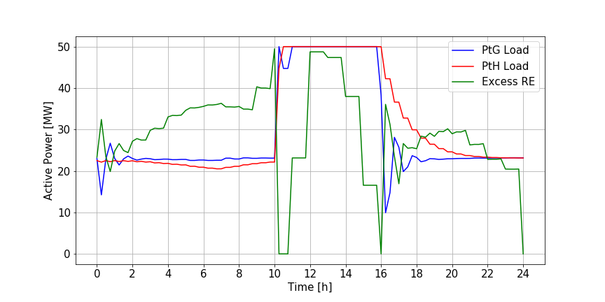
Results – Power System Analysis, Case 2
From 10:00 to 16:00, optimal deployment of flexibility is able to save 2.75€ with respect to 100% PtG priority and 0.99€ with respect to 50% equal priority.

Slide 25
Conclusion
Detailed thermal models are necessary to accurately represent the efficiency of PtX otherwise flexibility analysis may result with defective outcomes on active power consumption or energy production of PtX.
Optimal deployment of flexibility is able to provide operational cost savings for MES. Multi-layer structure of agent-based hierarchical control enables the implementation of local control objectives for the agents individually and a global objective for MES.
The relevance of co-simulation and Energysim for flexibility analysis of multi-energy systems is clearly supported by the current methodology.
MES: Multi Energy System
PtX: Power-to-X

Slide 26
References
[1] Jens Weibezahn. Data Documentation 92: Electricity, Heat, and Gas Sector Data for Modeling the Ger- man System.DIW Berlin, 2017, (ISSN 1861-1532), 2017.
[2] Stefan Pfenninger and Iain Staffell. URL http://www.renewables.ninja/.
[3] B. Felten, J. P. Baginski, and C. Weber, “KWK-Mindest- und Maximaleinspeisung - Die Erzeu- gung von Zeitreihen für die Energiesystemmodellierung,” no. 10, 2017.
[4] A. Bloess, W. P. Schill, and A. Zerrahn, “Power-to-heat for renewable energy integration: A review of technologies, modeling approaches, and flexibility potentials,” Appl. Energy, vol. 212, no. August 2017, pp. 1611–1626, 2018.
[5] J. Webster and C. Bode, “Implementation of a Non-Discretized Multiphysics PEM Electrolyzer Model in Modelica,” Proc. 13th Int. Model. Conf. Regensburg, Ger. March 4–6, 2019, vol. 157, pp. 833–840, 2019.
[6] C. Bode and G. Schmitz, “Dynamic simulation and comparison of different configurations for a coupled energy system with 100% renewables,” Energy Procedia, vol. 155, pp. 412–430, 2018.

Slide 27
Multi Energy Systems: Investigating Hidden Flexibilities Provided by Power-to-X Considering Grid Support Strategies
MSc: Bekir Caner Yagci (4857089)
PhD: Digvijay Gusain
Supervisor: Asst. Prof. Milos Cvetkovic
E-mail: B.C.Yagci@student.tudelft.nl
Version Control: https://github.com/caneryagci/Multi-Energy-Systems-Thesis-Project.git

